Slide 1




Slide 2
Table QA
Notes:
Hello and welcome, in this video we will start to dive into the components of the internal structure of transformers.

Slide 3
In this video
Explore how transformers can be used to extract information from tables and answer questions.

Slide 4
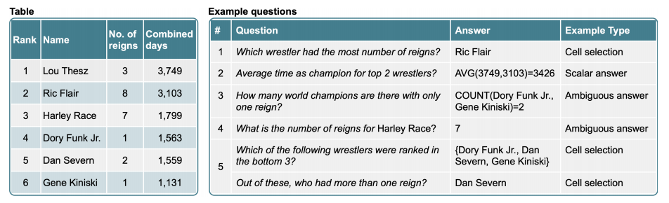
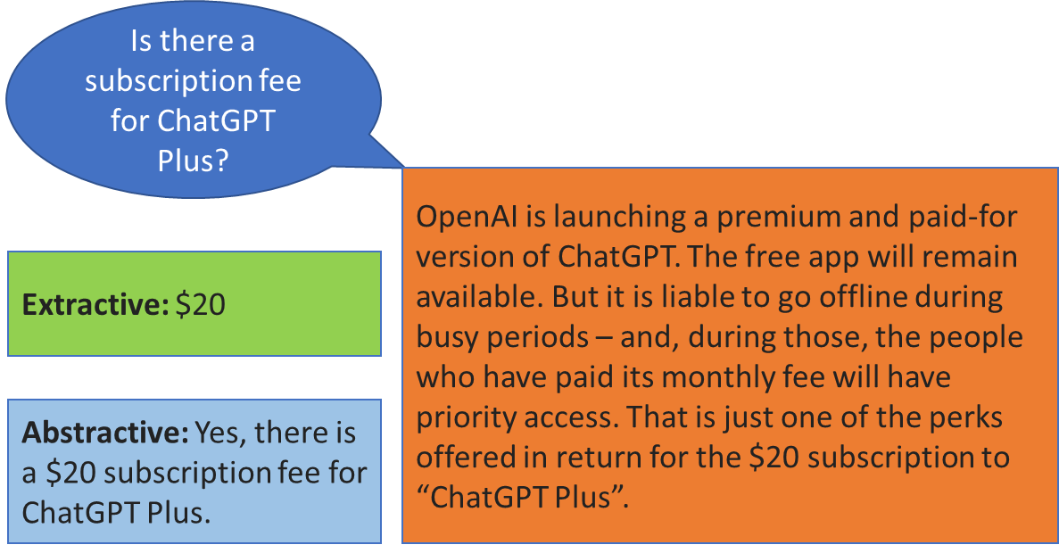
Introduction
Problem:
A lot of data, such as customer data within a company, is stored in structured databases instead of as raw text.

Slide 5
TAPAS Model
TAPAS model → Table Parser.
Apply the Transformer architecture to tables by combining the tabular information with the query.
Designed to understand and process tabular data, such as spreadsheets or structured databases.
Provide accurate responses to natural language questions related to the information present in the tables.
Utilizes a combination of pre-training and fine-tuning techniques to learn from large amounts of data.
Allowing it to generalize well to different table-based question-answering tasks.

Slide 6
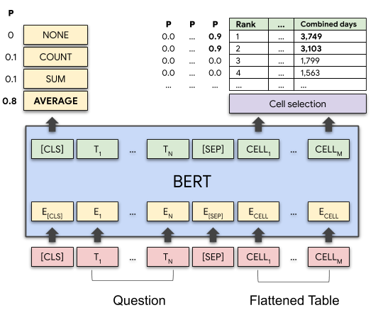
TAPAS Model
TAPAS Model: A BERT-based model specifically designed and pre-trained for answering questions about tabular data.
TAPAS is pre-trained on MLM objectives on a large dataset comprising millions of tables from English Wikipedia and corresponding texts.
For question answering, TAPAS has 2 heads on top:
Cell selection head
Aggregation head
TAPAS has been fine-tuned on:
Sequential Question Answering by Microsoft (SQA)
Wiki Table Questions by Stanford University (WTQ)
WikiSQL by Salesforce.

Slide 7
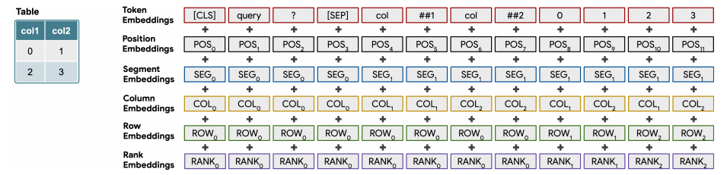
TAPAS relative position embeddings
TAPAS uses relative position embeddings and has 7 token types that encode the tabular structure of data:
[CLS]: The classification token → encodes the beginning of the table.
[SEP]: The separation token → indicates the boundary between different parts of the input.
[PAD]: The padding token → fills empty cells or makes the table structure conform to a fixed size.
[COL]: Column header → encodes the names or labels of the table columns.
[TYPE]: The type of token → indicates the data type of a column.
[CELL]: Specific cell in the table → It encodes the actual values present in the cells.
[MASK]: The masking token → helps the model learn to predict missing values in the table.

Slide 8
How TAPAS works in practice?

Slide 9
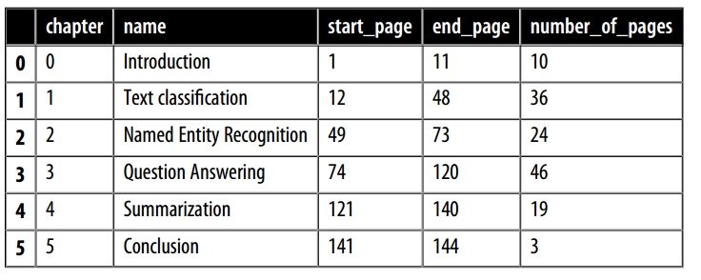
How TAPAS works?
Suppose you have this table as a data frame called table.

Slide 10


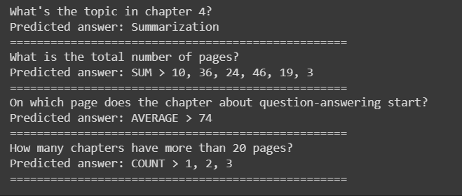
How TAPAS works?
Suppose you have this table as a data frame called table.
from transformers import pipeline
table_qa = pipeline("table-question-answering" )
queries = ["What's the topic in chapter 4?" ,
"What is the total number of pages?" ,
"On which page does the chapter about question-answering start?" ,
"How many chapters have more than 20 pages?" ]
preds = table_qa(table, queries)
for query, pred in zip(queries, preds):
print(query)
if pred["aggregator" ] == "NONE" :
print("Predicted answer: " + pred["answer" ])
else:
print("Predicted answer: " + pred["answer" ])
print('=' *50)

Slide 11



Why TAPAS?
The ability to ask questions in natural language → allows a much wider audience to query the data to answer specific questions.

